Slide 1
Analyzing NCAA CFB Playoff Contenders and Oklahoma: A Reddit Sentiment Analysis
Noah Hunter, Sam Harkins, Braum Russell, Nate Pumphrey, Lucas West, Kayla Nguyen, Jacob Conger
Notes:
Noah

Slide 2
Problem Statement
With the 2024 NCAA CFB season being the first year of a 12-team playoff and Oklahoma now in the SEC, we aim to determine how likely fans believe the Sooners will make the playoffs.
Goals:
Identify which teams are most mentioned in Reddit discussions about attending the playoffs.
Determine the sentiment of Oklahoma fans when discussing their team
Notes:
Noah

Slide 3
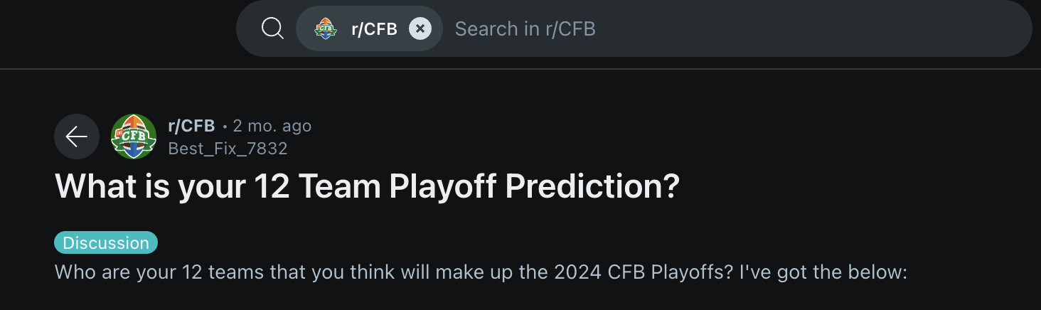
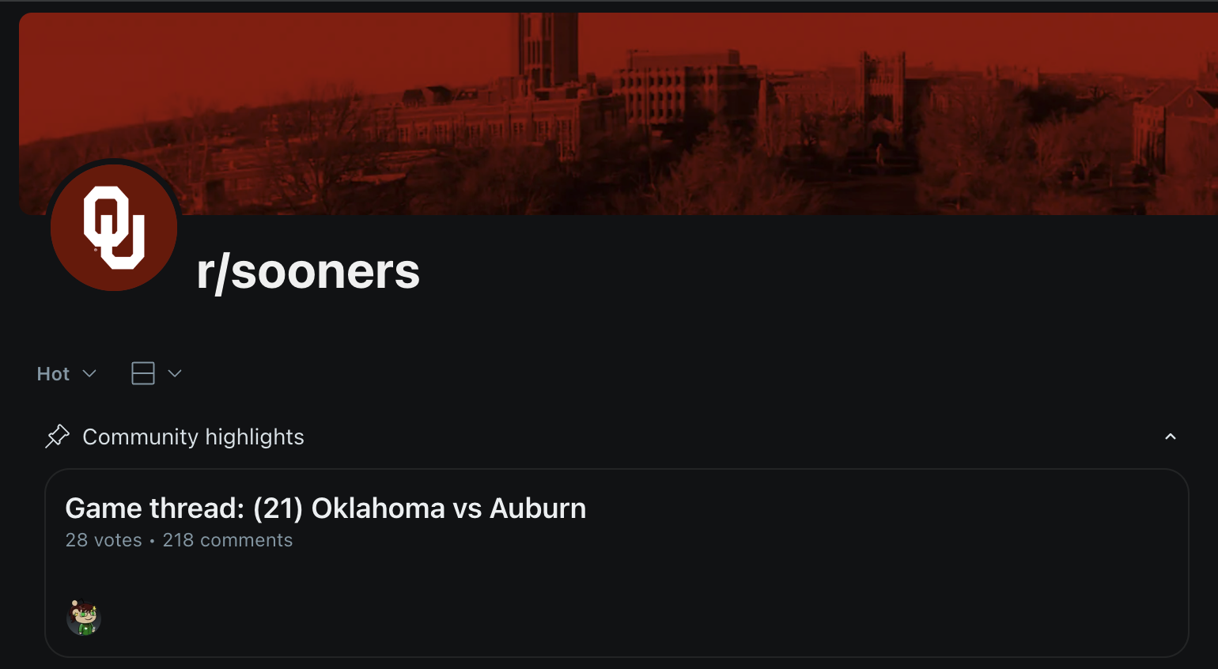
Description of data
Notes:
Sam

Slide 4
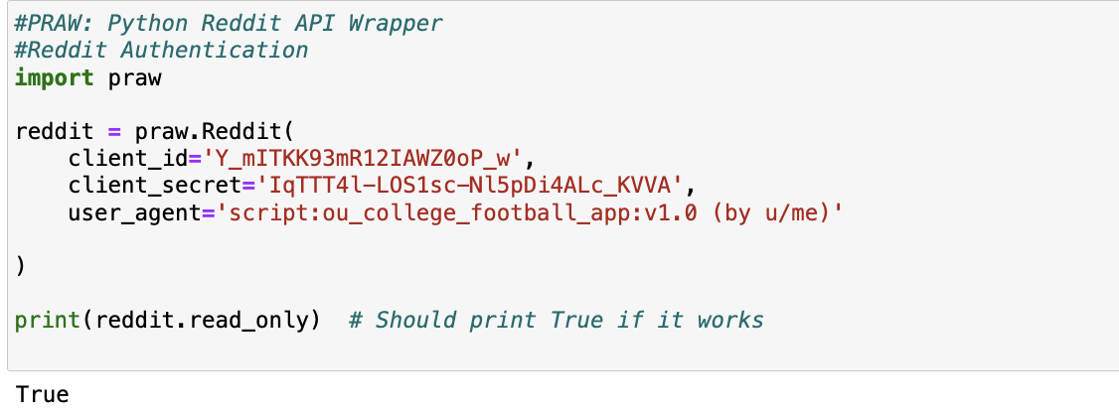
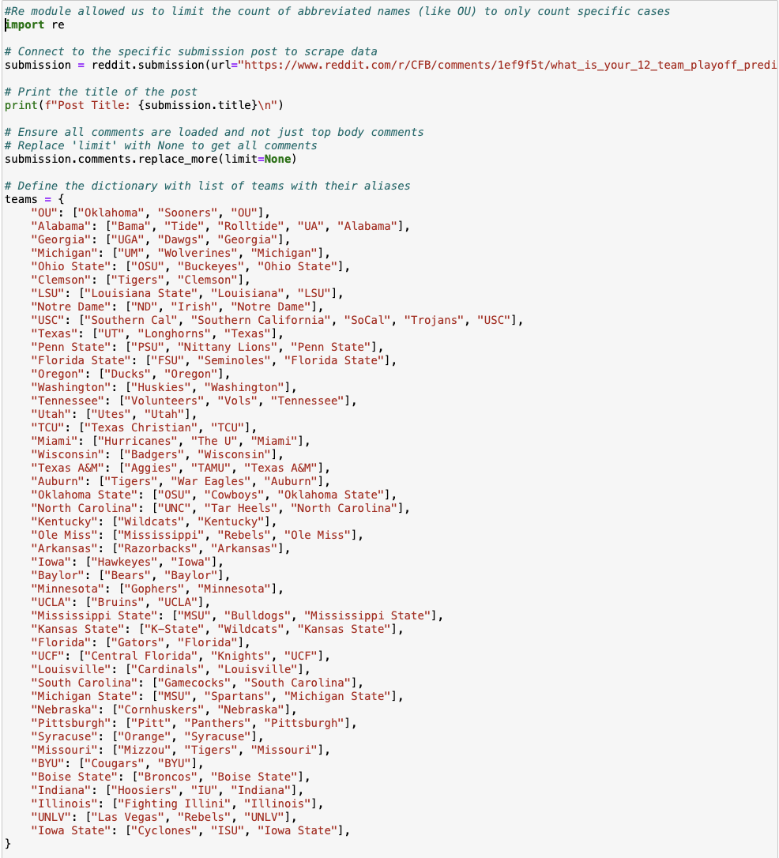
Code: Counting Team mentions
Notes:
Braum

Slide 5
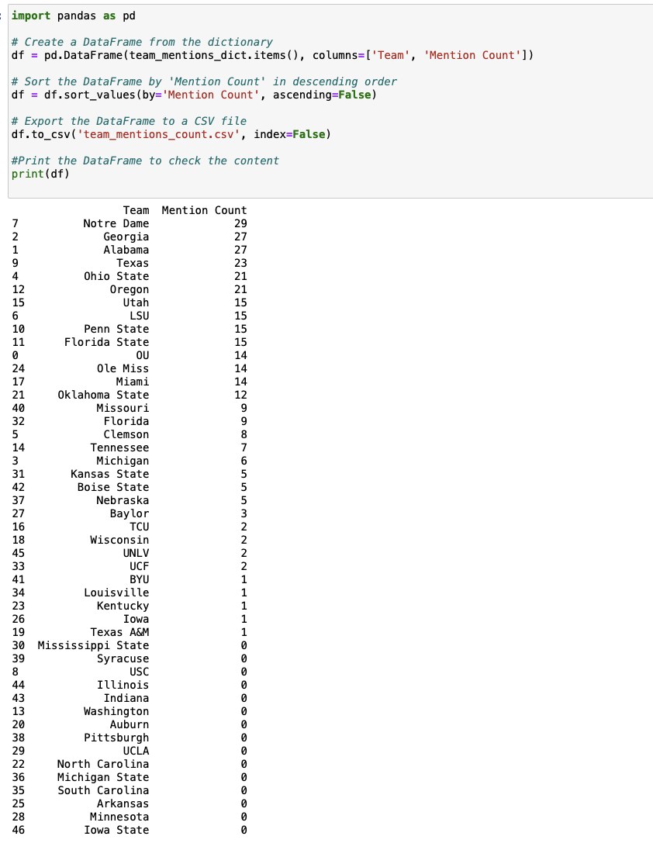
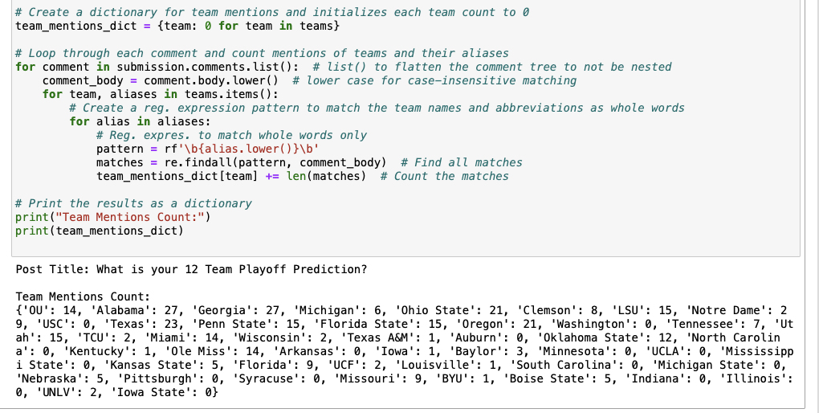
Code: Counting Team mentions
Notes:
Braum

Slide 6
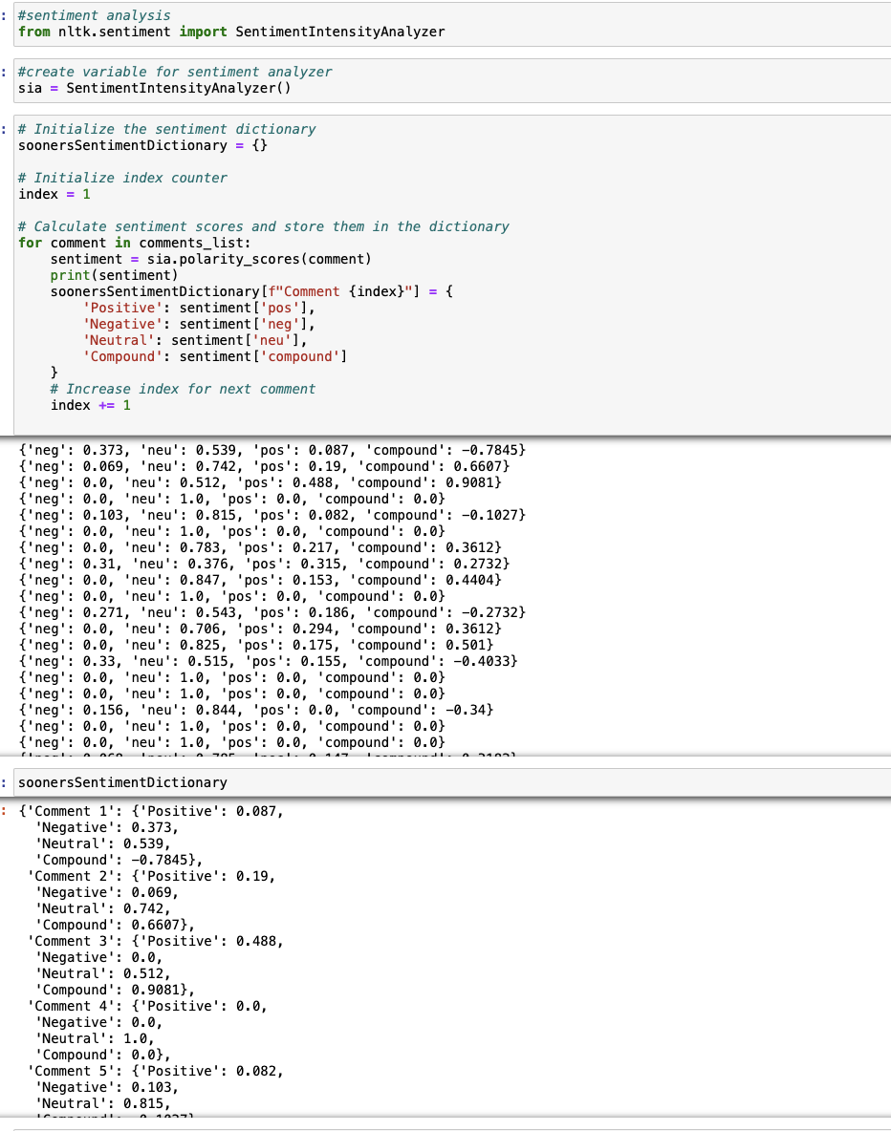
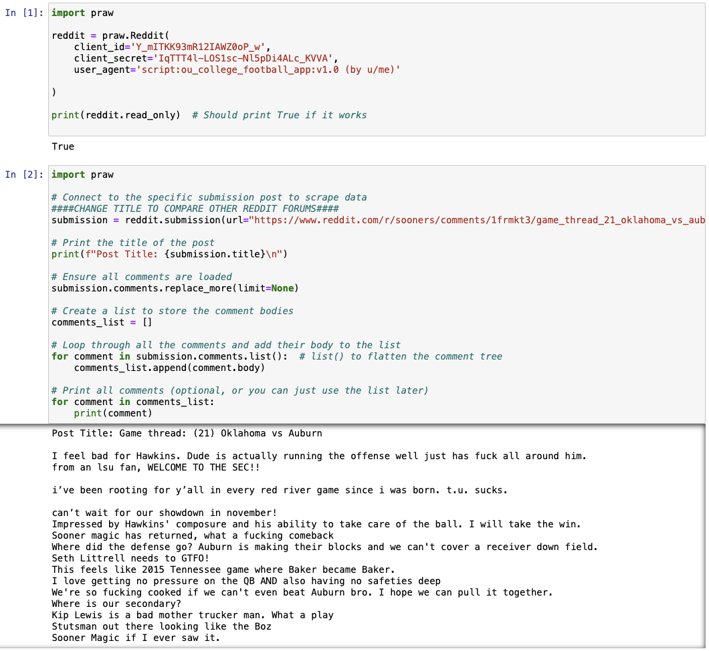
Code: Computing sentiment scores of Oklahoma games
Notes:
Braum

Slide 7
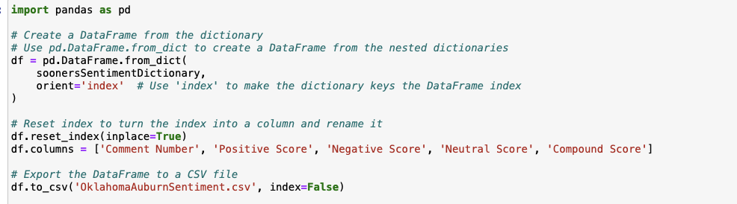
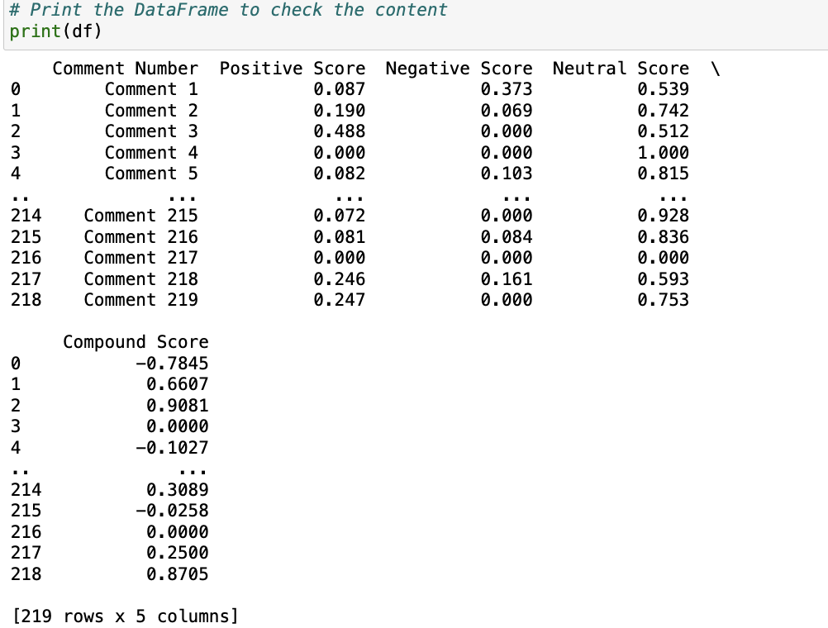
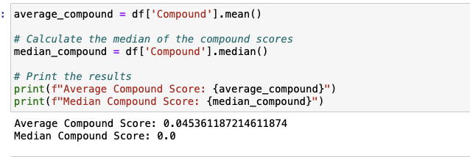
Code: Computing sentiment scores of Oklahoma games
Notes:
Braum

Slide 8
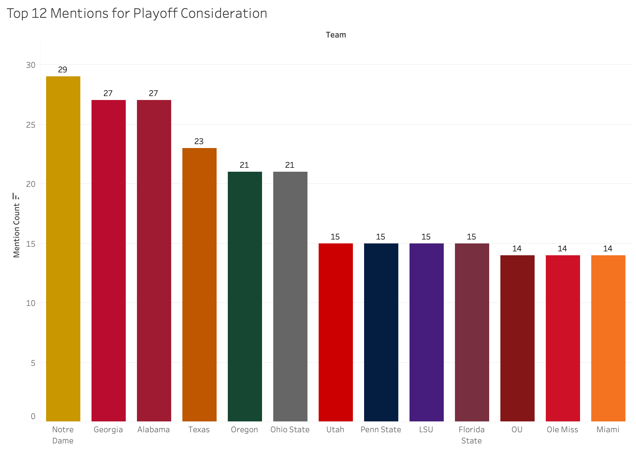
Top 12 teams
Notes:
Nate

Slide 9
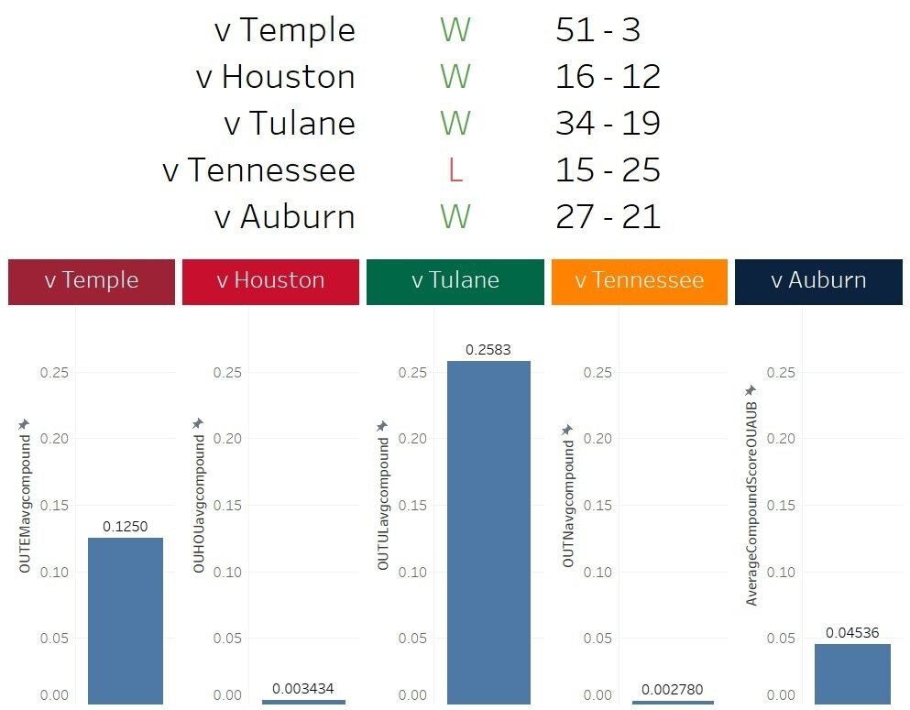
Sentiment compound scores over games
Notes:
Lucas

Slide 10
Conclusion
Notre Dame, Alabama, and Georgia emerged as the most favored teams to make the playoffs, based on the frequency of mentions.
Oklahoma was tied at the 11th spot, being a low contender for the College Football Playoff among Reddit users.
This aligns with our sentiment analysis, where we found Oklahoma’s compound sentiment score to be low, averaging at 0.0870
Versatility of the Model:
Our model can be leveraged for other sports
E.x. softball, gymnastics, or beyond college
Notes:
Kayla

Slide 11
Comment HighlighTS
Temple: "Is Boz wearing a Harambe hat?"
Houston: "Sadly we suck RN and it's infuriating"
Tulane: "It’s like I’m at Thanksgiving with my mom’s side of the family."
Tennessee: "Heupel could come out right now in his current state and play better than JA."
Auburn: "Kip Lewis is a bad mother trucker man. What a play"
Notes:
Jake

